Slide 1
UI Test Report & Details
Tested Site: Evershop
Test Type: UI Testing
Testing Part: Checking Shopping Cart UI
Tested On Device: Asus VivoBook 15
Bug Report Created By: Fouzia Mozumder Himi

Slide 2
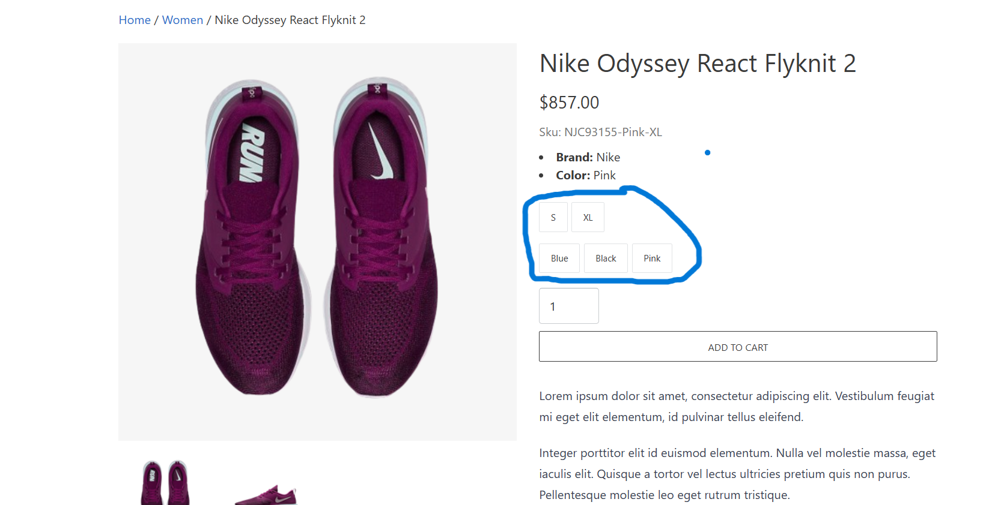
Test operation no: 1
Item Color and Size are not selected on UI

Slide 3
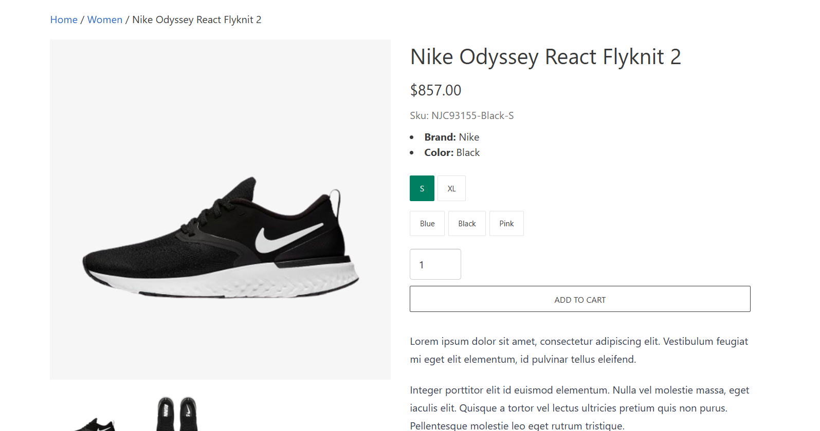
Test operation no: 2
When I select “S” Small size, the Product change to Black color but in UI Black color is not selected

Slide 4
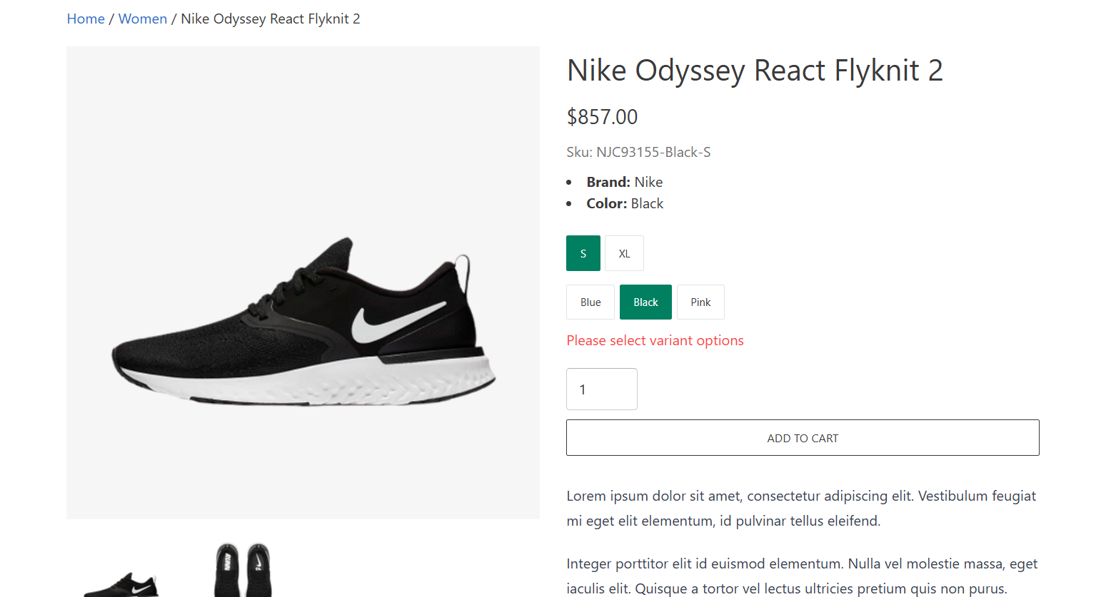
Test operation no: 3
After Selecting all the variant options still, “Please Select variant options” is still there

Slide 5
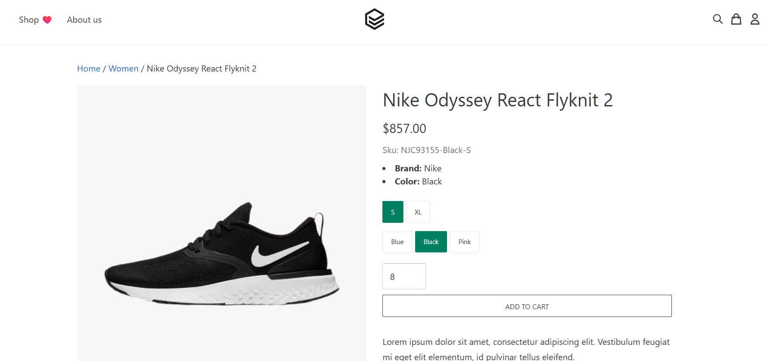
Test operation no: 4
Can not add 8 items to cart but no error message is showing

Slide 6
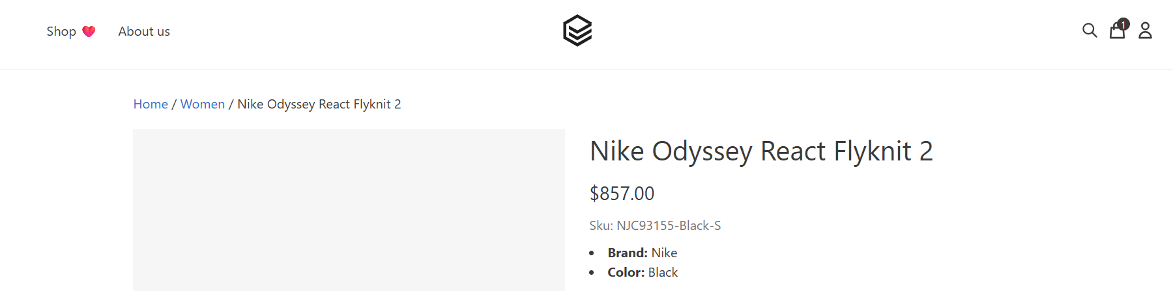
Test operation no: 5
Cart is empty but still showing 1 item
Product image is not showing

Slide 7
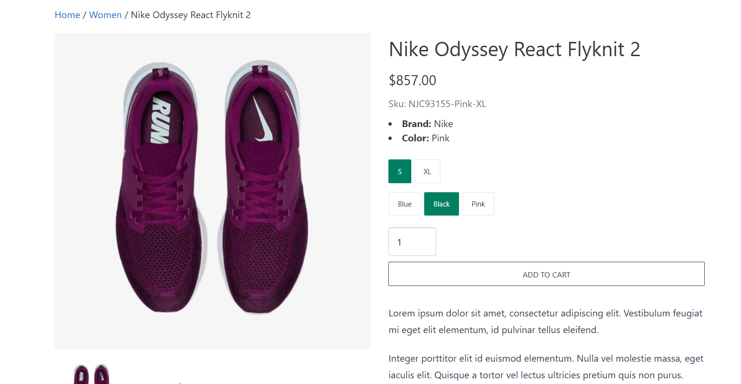
Test operation no: 5
Product color and size is not matched
Product color and size does not matched with UI

Slide 8
Bug Report
Suggestion: I have some suggestions to make the UI more user friendly:
Item Color and Size should be selected on UI.
When I select “S” Small size, the Product should not change Black color until i select one.
After Selecting all the variant options, “Please Select variant options” should not be still there.
Can not add 8 items to cart but no error message is showing.
When Cart is empty it should not show any item.
Product is selected Black and small size but in product the image is not correct.
From All the bugs which are listed in the slide, I came to a conclusion that the UI Part does not have any major issue but needs to be developed and solve all the bugs for better user experience, response and good business.

